Slide 1
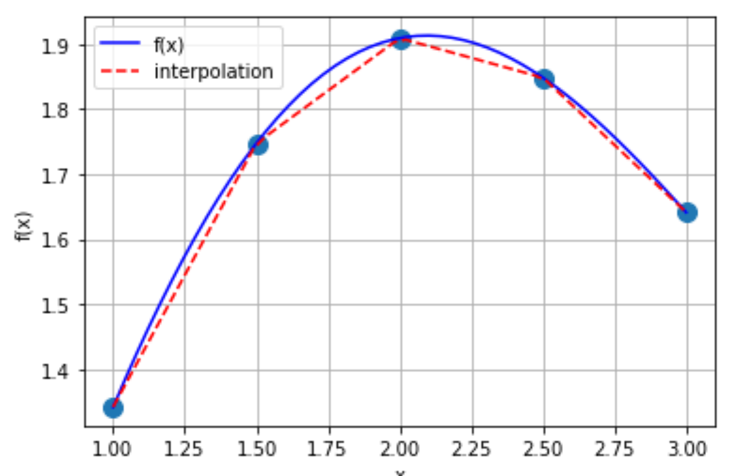

Interpolation using scipy

Slide 2
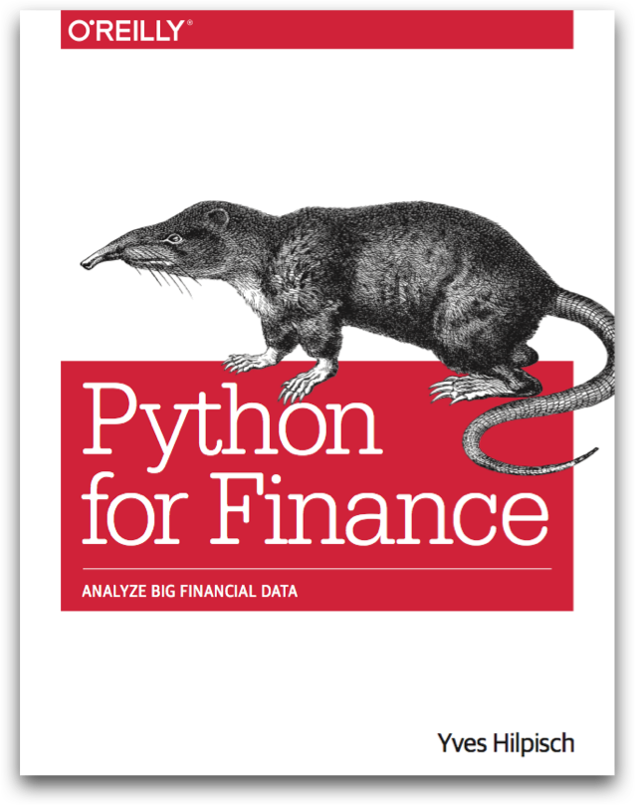
Reference
Chapter 9 of Python for Finance (O'Reilly)
Youtube
Code

Slide 3
1st order interpolation

Slide 4
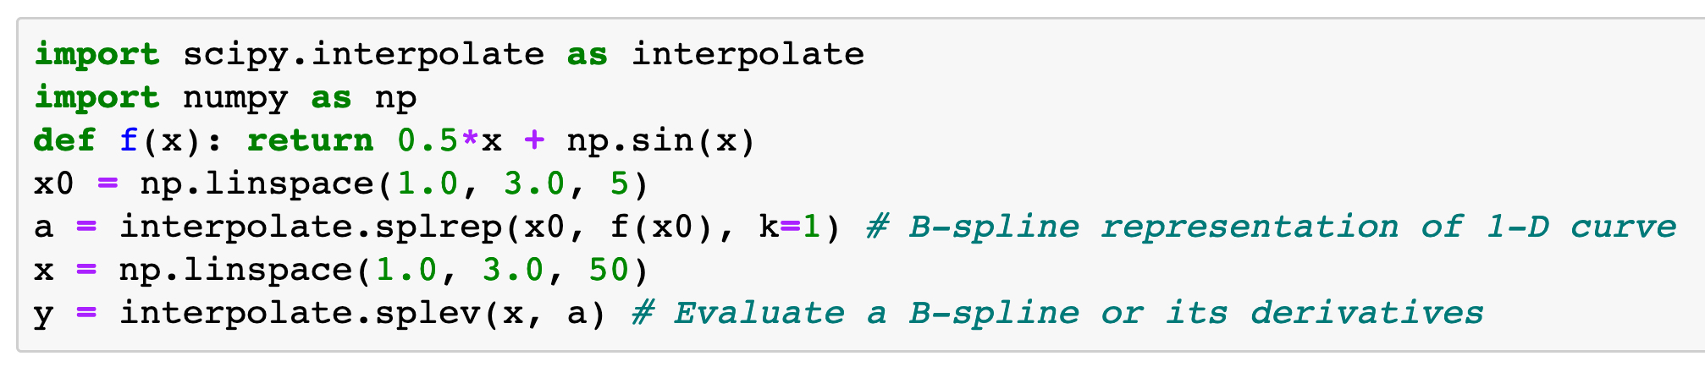

Slide 5
spline_representation

Slide 6
spline_representation
x_data

Slide 7
spline_representation
x_data
y_data

Slide 8
spline_representation
1st order interpolation
x_data
y_data

Slide 9
Interpolation Object
spline_representation
1st order interpolation
x_data
y_data

Slide 10
spline_evaluation

Slide 11
spline_evaluation
places_to_interpolate

Slide 12
spline_evaluation
Interpolation Object
places_to_interpolate

Slide 13
Interpolated_values
spline_evaluation
Interpolation Object
places_to_interpolate

Slide 14
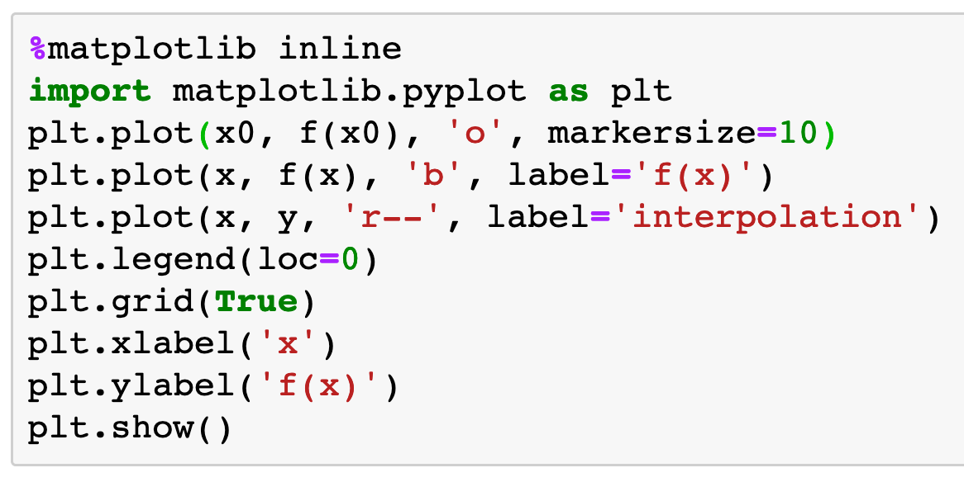

Slide 15
3rd order interpolation

Slide 16

3rd order interpolation

Slide 17
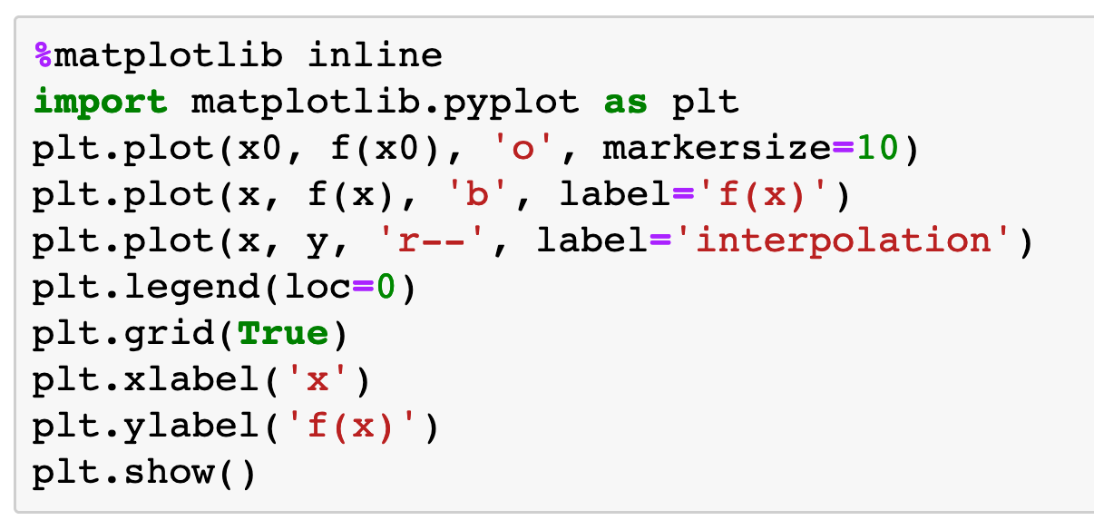
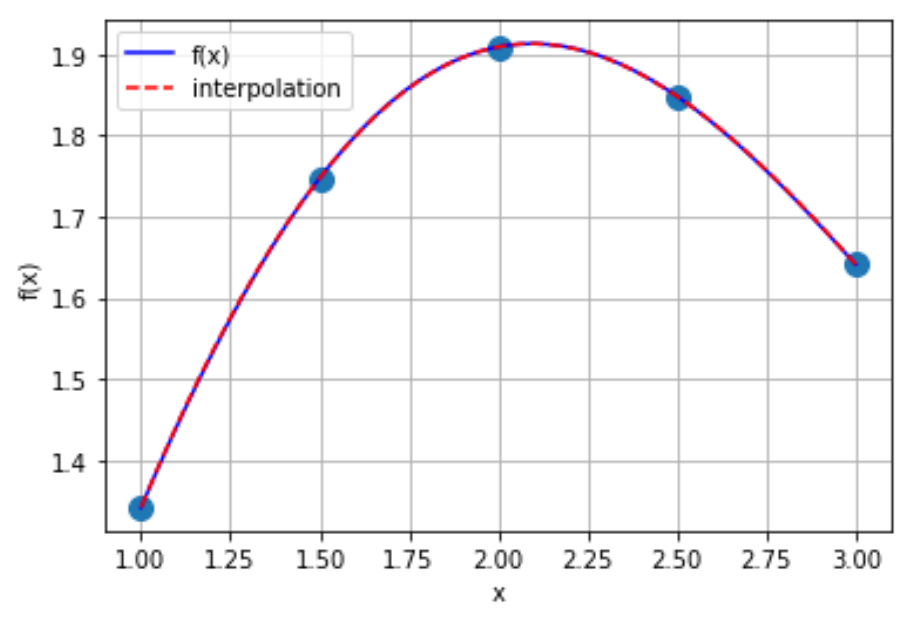

Slide 18
Now
Let’s Play with Code

